Slide 1
Izobraževanja in delavnice na temo managementa mestnih središč Workshops on Town Centre Management
Projekt financiran s strani Ministrstva za gospodarski razvoj in tehnologijo in SPIRIT Slovenija, javna agencija
Project financed by the Ministry of Economic Development and Technology and the SPIRIT Slovenija public agency
Miran Košpenda, ZMOS
Postojna, 28. marec 2017

Slide 2
O projektu / about the project
Namen
Purpose
Spodbujati in promovirati pristop MMS med slovenskimi mesti. Spodbujati sodelovanje lokalne skupnosti in podjetnikov iz mestnih središč kot pot k oživljanju mestnih jeder.
To promote the TCM approach to Slovenian cities. To promote the cooperation between local public government and enterprises from the city centre as a solution for city centre revitalization.
Izvedba
Activities
9 delavnic z razpravami in evalvacija.
9 workshops with discussions and an evaluation.

Slide 3
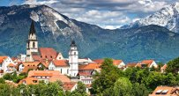
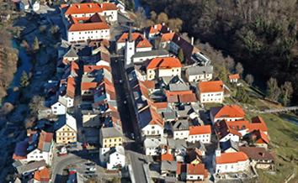
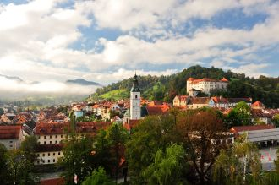
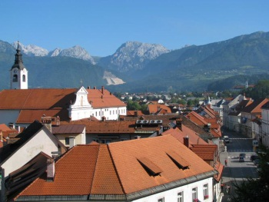
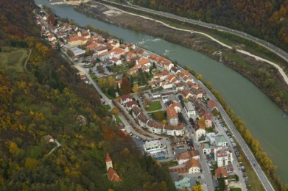
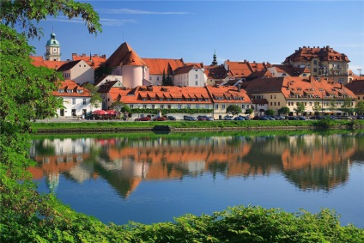
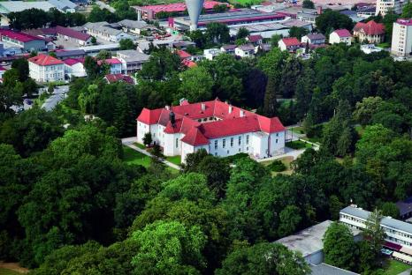
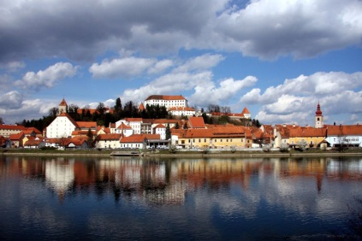
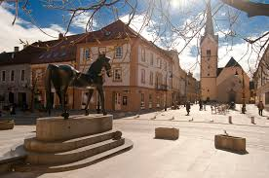
Delavnice / Workshops
Kranj, 31. 5. 2016
Črnomelj, 23. 8. 2016
Škofja Loka, 25. 8. 2016
Kamnik, 6. 10. 2016
Krško, 11. 10. 2016
Sl. Gradec, 15. 9. 2016
Maribor, 13. 10. 2016
M. Sobota, 17. 10. 2016
Ptuj, 19. 10. 2016

Slide 4
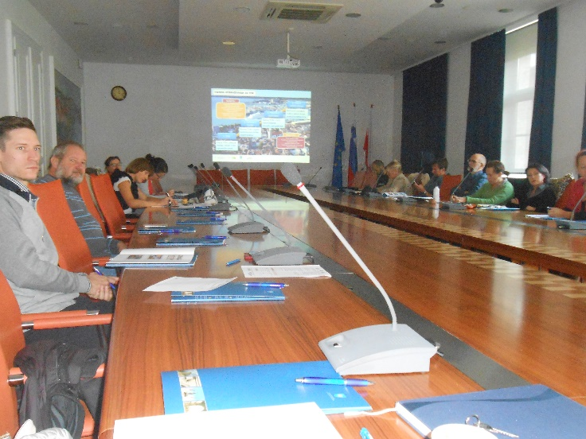
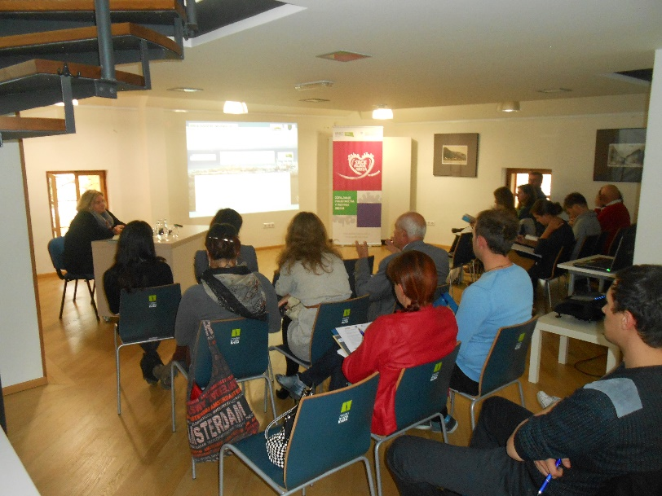
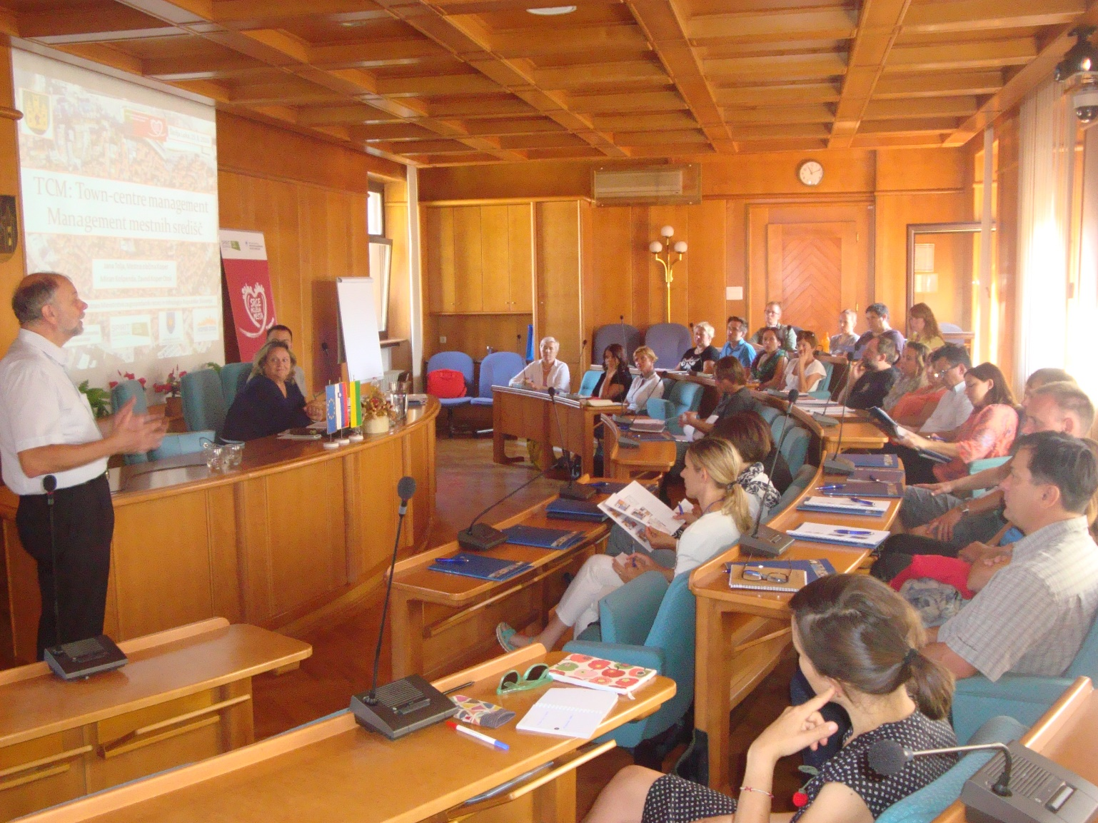
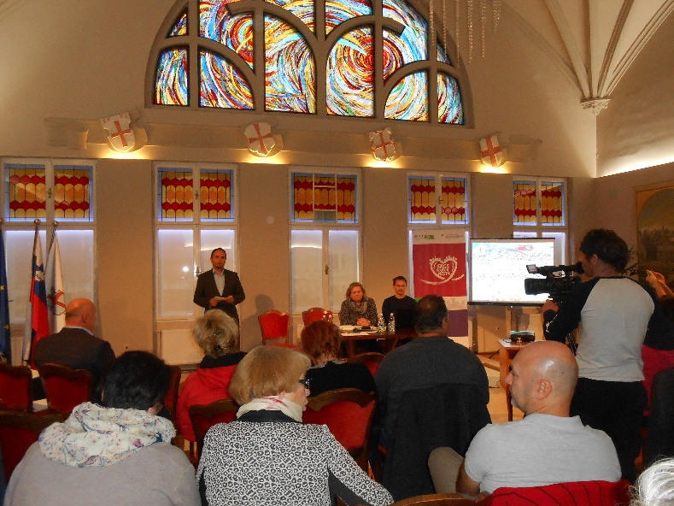
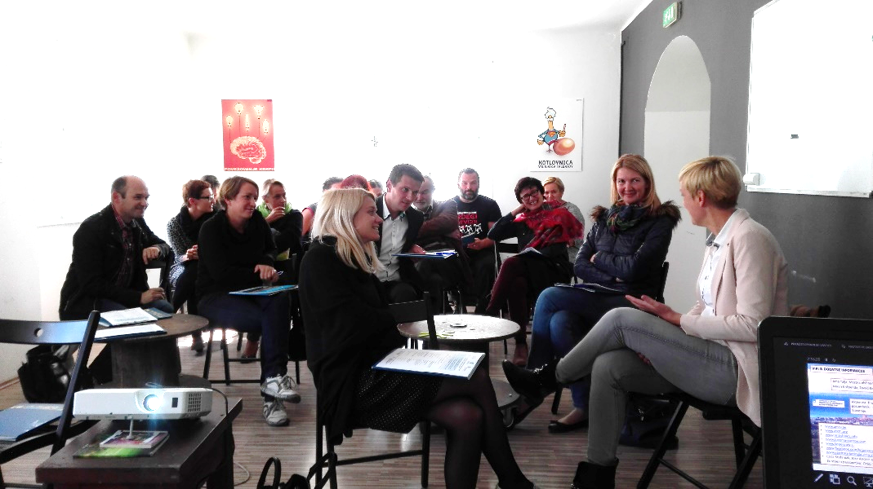
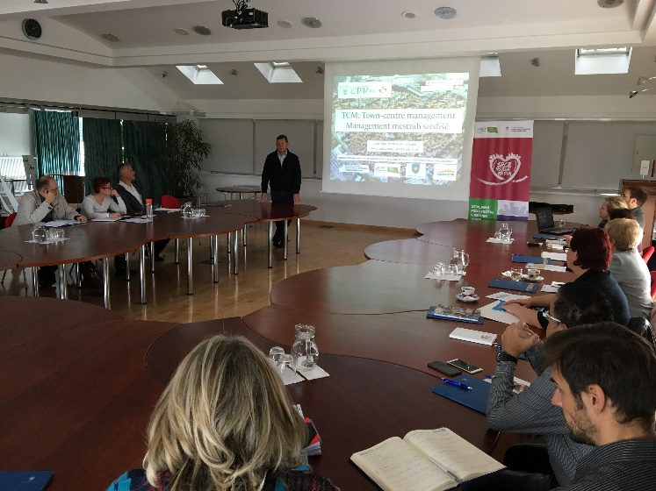
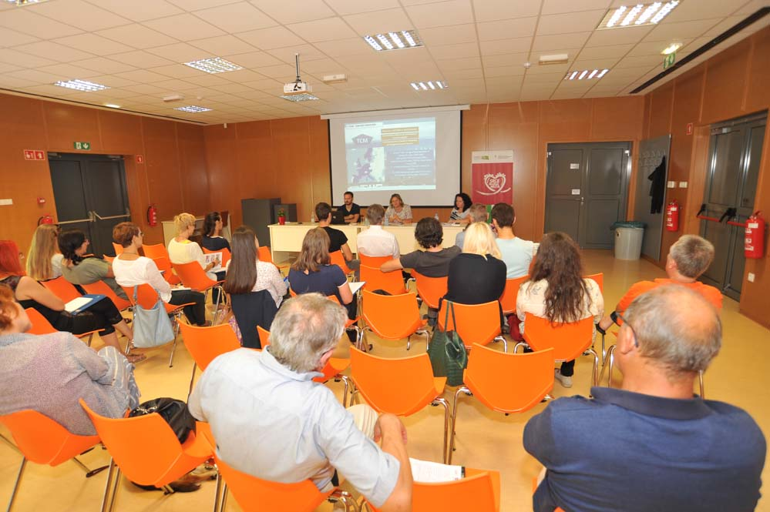
Delavnice / Workshops

Slide 5
EVALVACIJA / evaluation
Omejeno število anket – ne predstavlja celotne slike mestnih jeder.
Pokazatelj mnenja dela deležnikov.
Limited number of surveys – does not represent a wholesome picture of the city centre.
N= 129
Indicator of opinion of a part of stakeholders.
55 % udeležencev

Slide 6
EVALVACIJA / evaluation
Omejeno število anket – ne predstavlja celotne slike mestnih jeder.
Pokazatelj mnenja dela deležnikov.
Limited number of surveys – does not represent a wholesome picture of the city centre.
N= 129
Indicator of opinion of a part of stakeholders.
55 % udeležencev

Slide 7
EVALVACIJA / evaluation
Omejeno število anket – ne predstavlja celotne slike mestnih jeder.
Pokazatelj mnenja dela deležnikov.
Limited number of surveys – does not represent a wholesome picture of the city centre.
N= 129
Indicator of opinion of a part of stakeholders.
55 % udeležencev

Slide 8
EVALVACIJA / evaluation
Omejeno število anket – ne predstavlja celotne slike mestnih jeder.
Pokazatelj mnenja dela deležnikov.
Limited number of surveys – does not represent a wholesome picture of the city centre.
N= 129
Indicator of opinion of a part of stakeholders.
55 % udeležencev

Slide 9
EVALVACIJA / evaluation

Slide 10
EVALVACIJA / evaluation

Slide 11
EVALVACIJA / evaluation

Slide 12
EVALVACIJA / evaluation

Slide 13
EVALVACIJA / evaluation
Is there support for networking and cooperation from the municipal structures?
Is there support for networking and cooperation from entrepreneurs from the city centre?

Slide 14
EVALVACIJA / evaluation
Good
Assessment of efforts from the municipality
Average
Assessment of engagement from the entrepreneurs
Insufficient

Slide 15
EVALVACIJA / evaluation
Increased
Decreased

Slide 16
EVALVACIJA / evaluation
Not enough parking space
Competition of shopping centres
Excessive rents
Too many vacant spaces
Insufficient number of events
Insufficient number of visitors
Other

Slide 17
EVALVACIJA / evaluation
Druge prepoznane glavne ovire / Other identified problems
Neprimerna ponudba
Pomanjkanje sodelovanja
Degradirane nepremičnine
Pasivnost prebivalstva
Bližina nakupovalnih središč
Neustrezna prometna ureditev
Inadequate offer
Lack of cooperation
Degraded real estate
Passiveness of the population
Closeness of shopping centres
Inadequate traffic regime
Not enough parking space
Competition of shopping centres
Excessive rents
Too many vacant spaces
Insufficient number of events
Insufficient number of visitors
Other

Slide 18
EVALVACIJA / evaluation
Druge prepoznane glavne ovire / Other identified problems
Prioritetna področja / Priority actions
Neprimerna ponudba
Pomanjkanje sodelovanja
Upravljanje nepremičnin
Urejanje prometa
Spodbude za gospodarstvo
Degradirane nepremičnine
Pasivnost prebivalstva
Bližina nakupovalnih središč
Omilitveni ukrepi za nakupovalna središča
Destinacijski management
Ozaveščanje prebivalstva
Neustrezna prometna ureditev
Inadequate offer
Lack of cooperation
Property management
Traffic management
Economic incentives
Degraded real estate
Passiveness of the population
Closeness of shopping centres
Mitigation measures in relation to shopping centres
Destination management
Raising awareness of local population
Inadequate traffic regime
Not enough parking space
Competition of shopping centres
Excessive rents
Too many vacant spaces
Insufficient number of events
Insufficient number of visitors
Other

Slide 19
EVALVACIJA / evaluation
Druge predlagane skupne aktivnosti:
Izvajanje koordinacije med podjetniki
Enotni marketing za mestno središče
Povezovanje podjetnikov, zagovarjanje skupnih interesov
Other identified common activities:
Coordination between businesses
Common marketing efforts
Networking and lobbying for businesses
Common events
Common promotion
None of listed
Common printed material
Unified dialogue with the municipality

Slide 20
EVALVACIJA / evaluation
Videnje vloge občin / Role of municipalities
Omogoča ali izvaja koordinacijo ponudnikov in aktivnosti
Finančna podpora za MMS in podjetnike (najemnine, sofinanciranje itd.)
Upravljanje praznih prostorov, privabljanje novih podjetij, institucij
Enables or conducts the coordination of activities and SMEs
Financial support for TCM and businesses (rents, subsidies, co-financing etc.)
Management of empty properties, attracting new businesses, institutions

Slide 21
EVALVACIJA / evaluation
Skupna promocija in prireditve kot glavni povezovalni element na nacionalni ravni.
Unified promotional activities and events at the national level as preferred common actions.
City loyalty cards
Common promotion
Develop. of new tourist products
Other
City vouchers
Common events

Slide 22
UGOTOVITVE / Main findings
Velika podpora vprašanih uvajanju pristopa MMS / Huge support for the implementation of TCM
Načelna pripravljenost deležnikov za sodelovanje v MMS / In principle stakeholders willing to participate in TCM
MMS primarno potreben zaradi spodbujanja koordinacije, sodelovanja in povezovanja deležnikov / TCM mainly needed to support the coordination, cooperation and networking of stakeholders
Vloga MMS za razvoj mestnega središča, reševanje skupnih težav, potrebe po boljšem marketingu / Role of TCM for city centre development, finding solutions to common problems, to address the needs for better marketing

Slide 23
HVALA / Thank you
Koper.center@gmail.com
Miran.kospenda@koper.si
Projekt financiran s strani Ministrstva za gospodarski razvoj in tehnologijo in SPIRIT Slovenija, javna agencija
Project financed by the Ministry of Economic Development and Technology and the SPIRIT Slovenija public agency

